Slide 1
SPAM MAIL FILTERING SYSTEM Project ID:2020MP115 Review -II
Group Members
RA1611003030473 ASHAY MISHRA
RA1611003030490 GAURAV BAKHRU
RA1611003030505 KUSHAGRA SAXENA
RA1611003030446 AGAMYA MEHROTRA
Supervised By:
MS MEGHA AGARWAL
SRM Institute of Science & Technology
SPAM MAIL FILTERING SYSTEM
April 15, 2020 1 / 18

Slide 2







Table Of Contents
Abstract
Literature Survey
Identification of Research Gap and Problem
4
Expected Impact on Academics/ Industry
5
Methodology of the Project Work
6
Detailed Design
7
Results Obtained
8
References
SPAM MAIL FILTERING SYSTEM

Slide 3
Abstract
Spam is a universal problem with which everyone is familiar. A numberof approaches are used for Spam filtering .
The most common filtering technique is content -based filtering which uses the actual text of message to determine whether it is a spam or not.
The content is very dynamic and it is very challenging to represent all information in a mathematical model of classification.For instance, in content based spam filtering, the characteristics used by the filter to identify spam messages are constantly changing over time.
Naive Bayes method represent the changing nature of message using probability theory and support vector machine represent those using different features.
These two method of classification are efficient in different domain.
These two methods do not consider the issue and it is interesting to find out the performance of both the methods in the problem of email spam filtering.
In this project Naive Bayes and SVM classification techniques and other ML techniques will be implemented to classify
SPAM MAIL FILTERING SYSTEM

Slide 4
Literature Survey
Paper: An Efficient Spam Filtering Techniques for Email Account
Author and Year: S. Roy, A. Patra, S.Sau, K.Mandal, S. Kunar 2013
Conclusion: The email client system that has capability to send email and receive email and project mainly concerned about an efficient email spam filtering techniques for an email account. For this system, we collected statistical data by which we create a training set. This dataset is updated time by time. The filtering techniques based on Naive bayes Theorem, which is a good one machine learning algorithm.
SPAM MAIL FILTERING SYSTEM

Slide 5
Literature Survey
2. Paper : MACHINE LEARNING METHODS FOR SPAM E-MAIL CLASSIFICATION
Author and Date: W.A. Awad and S.M. Elseuofi,2011
Conclusion: In this paper we review some of the most popular machine learning methods and of their applicability to the problem of spam e-mail classification. Descriptions of the algorithms are presented, and the comparison of their performance on the Spam Assassin spam corpus is presented, the experiment showing a very promising results specially in the algorithms that is not popular in the commercial e-mail filtering packages
SPAM MAIL FILTERING SYSTEM

Slide 6
Identification of Research Gap and Problem
Many Email spam filtering systems are there but the cost is high.
Spam filters based on deep neural network are effective but training costs are high and need lot of data.
This system ,instead of using one system or algorithm combines several different algorithm to classify mail as spam or non spam
SPAM MAIL FILTERING SYSTEM

Slide 7
Expected Impact on Academics/ Industry
If this system is used it will help to classify mail more effectively and with a much lesser cost.
This idea of mail filtering maintain balance between cost effectiveness and classifying accuracy.
The senders can be punished, if tracked, under the cyber crime law.
SPAM MAIL FILTERING SYSTEM

Slide 8
Methodology of the Project Work
SVM(SUPPORT VECTOR MACHINE)
Support Vector Machine (SVM) is a supervised machine learning algorithm which can be used for both classification or regression challenges. However, it is mostly used in classification problems. In this algorithm, we plot each data item as a point in n-dimensional space with the value of each feature being the value of a particular coordinate.
Decision Trees
Decision Trees are a type of Supervised Machine Learning (that is you explain what the input is and what the corresponding output is in the training data) where the data is continuously split according to a certain parameter.
SPAM MAIL FILTERING SYSTEM

Slide 9
Methodology of the Project Work
Vectorization
A vectorized function takes a nested sequence of objects or numpy arrays as inputs and returns a single numpy array or a tuple of numpy arrays. The vectorized function evaluates pyfunc over successive tuples of the input arrays like the python map function, except it uses the broadcasting rules of numpy.
Naive Bayes Algorithm
Naive Bayes is a classification algorithm for binary (two-class) and multiclass classification problems. It is called Naive Bayes or idiot Bayes because the calculations of the probabilities for each class are simplified to make their calculations tractable.
SPAM MAIL FILTERING SYSTEM
April 15, 2020 10 / 18

Slide 10
Methodology of the Project Work
Data Preprocessing
Text Cleaning is a very important step in machine learning because your data may contains a lot of noise and unwanted character such as punctuation, white space, numbers, hyperlink and etc
Some standard procedures that people generally use are:
convert all letters to lower/upper case
removing numbers
removing punctuation
removing white spaces
removing hyperlink
removing stop words such as a, about, above, down, doing etc.
SPAM MAIL FILTERING SYSTEM
April 15, 2020 11/ 18

Slide 11
Methodology of the Project Work
Stemming
Stemming is the process of reducing inflection in words to their root forms such as mapping a group of words to the same stem even if the stem itself is not a valid word in the Language.It is a technique in the field of Natural Language Processing that are used to prepare text, words, and documents for further processing
Word Cloud
Word Cloud is a data visualization technique used for representing text data in which the size of each word indicates its frequency or importance. Significant textual data points can be highlighted using a word cloud. Word clouds are widely used for analyzing data from social network website
SPAM MAIL FILTERING SYSTEM
April 15, 2020 12 / 18

Slide 12
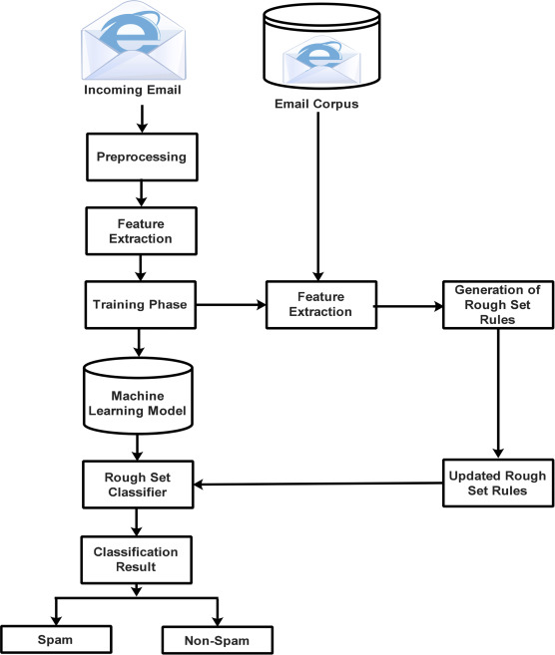
Detailed Design
ARCHITECTURAL DESIGN
SPAM MAIL FILTERING SYSTEM
April 15, 2020 13 / 18

Slide 13
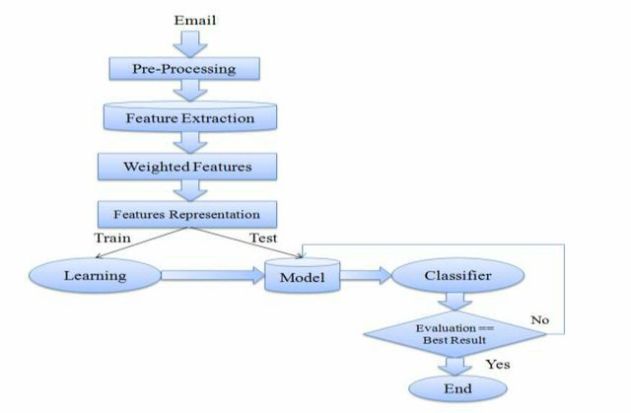
Detailed Design
DATA FLOW DIAGRAM
SPAM MAIL FILTERING SYSTEM
April 15, 2020 14 / 18

Slide 14
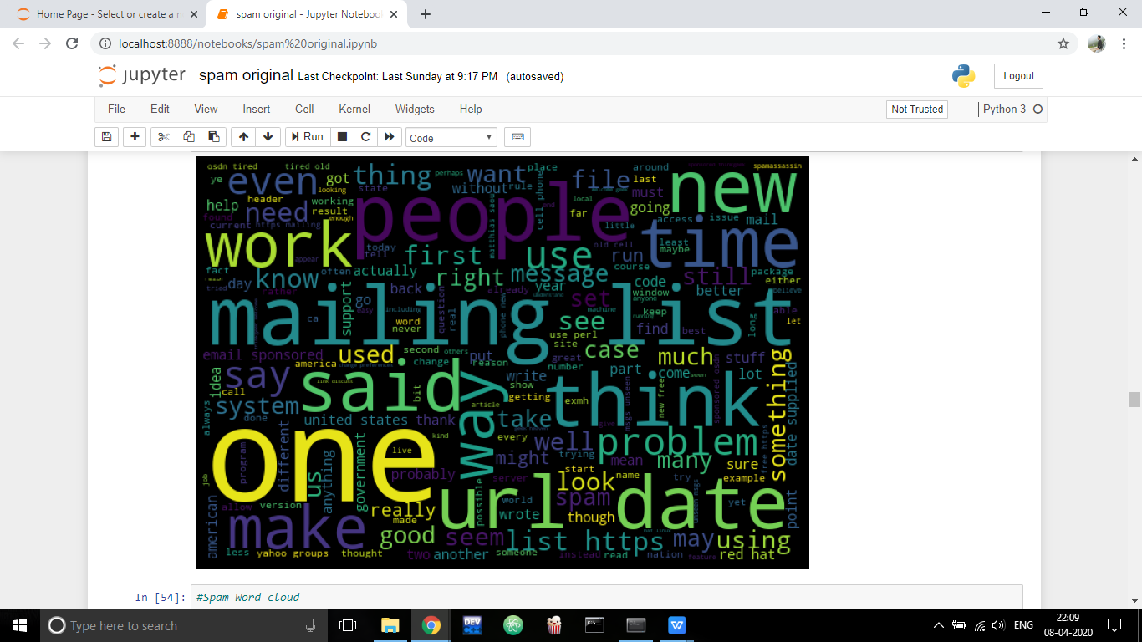
Results Obtained
SPAM MAIL FILTERING SYSTEM
April 15, 2020 15 / 18

Slide 15
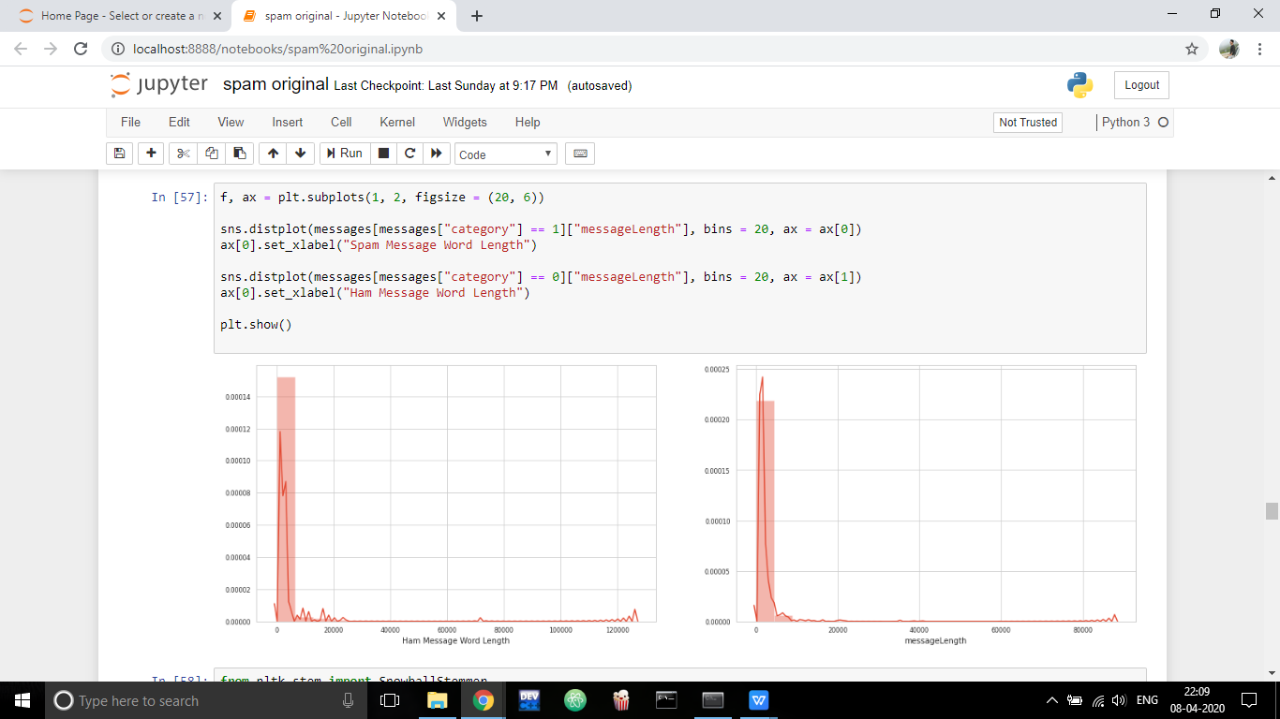
Results Obtained
SPAM MAIL FILTERING SYSTEM
April 15, 2020 16 / 18

Slide 16
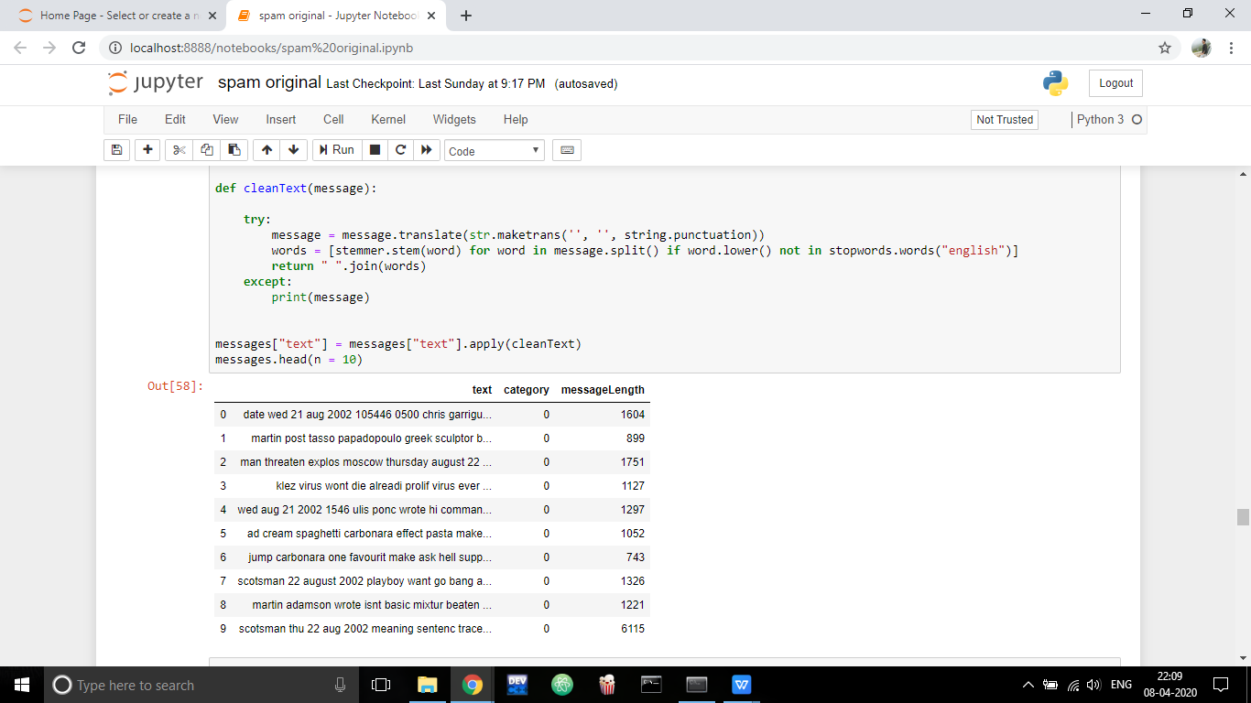
Results Obtained
SPAM MAIL FILTERING SYSTEM
April 15, 2020 17 / 18

Slide 17
References
Christina, V., S. Karpagavalli, and G. Suganya. 2010. “Email Spam Filtering using Supervised Machine Learning Techniques”. International Journal on Computer Science and Engineering. 2(09):3126-3129
Bahgat, E.M., S. Rady and W/ Gad. 2016. “An Email Filtering Approach using Classification Techniques”. In: The 1st International Conference on Advanced Intelligent System and Informatics (AISI2015), November 28-30, 2015. Springer International Publishing: BeniSuef, Egypt. 321331.
https://www.kaggle.com/ozlerhakan/spam-or-not-spam-dataset
https://www.researchgate.net/publication/320703241_E-Mail_Spam_Filtering_A_Review_of_Techniques_and_Trends
SPAM MAIL FILTERING SYSTEM
April 15, 2020 18/ 18

Slide 18
THANK YOU

